Slide 1
Electrical Circuit-I
10th Lecture
Summary 2

Slide 2
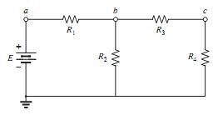
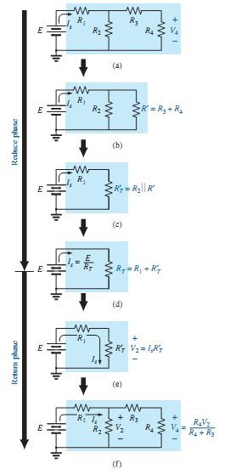
SERIES-PARALLEL NETWORKS:
A series-parallel configuration is one that is formed by a combination of series and parallel elements.
A complex configuration is one in which none of the elements are in series or parallel.
The network in Fig. shown is a series-parallel network. At first, you must be very careful to determine which elements are in series and which are in parallel.
series-parallel network

Slide 3
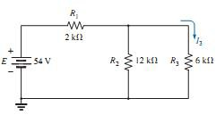
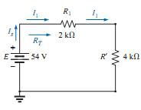
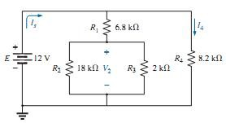
Example : Find current I₃ for the series-parallel network in Fig. below.
Solution:
Substituting the parallel equivalent resistance for
resistors R₂ and R₃
The source current is then determined using Ohm’s law:
I1 is the total current entering the parallel combination of R₂ and R₃ . Applying the current divider rule results in the desired current:
Example : For the network in Fig. below. Determine currents I₄ and I_{s} and voltage V₂.

Slide 4
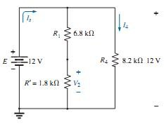
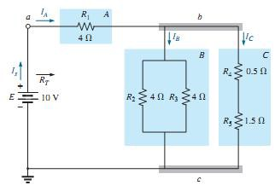
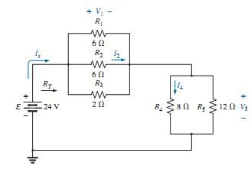
Solution:
H.W// Determine all the currents and voltages of the network in Fig. below.
H.W// Find the indicated currents and voltages for the network in Fig.

Slide 5
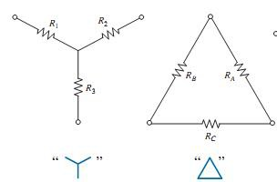
Y- Δ AND Δ-Y CONVERSIONS:
Circuit configurations are often encountered in which the resistors do not appear to be in series or parallel. Under these conditions, it may be necessary to convert the circuit from one form to another to solve for any unknown quantities if mesh or nodal analysis is not applied. Two circuit configurations that often account for these difficulties are the wye (Y) and delta (Δ) configurations depicted in Fig.
The purpose of this section is to develop the equations for converting from Δ to Y, or vice versa.
Delta to Star :
-Note that each resistor of the Y is equal to the product of the resistors in the two closest branches of the divided by the sum of the resistors in the Δ.

Slide 6
Star to Delta:
-Note that the value of each resistor of the Δ is equal to the sum of the possible product combinations of the resistances of the Y divided by the resistance of the Y farthest from the resistor to be determined.
Let us consider what would occur if all the values of a Δ or Y were the same. If R_{A} = R_{B} = R_{C},
The Y and Δ the often appear. They are then referred to as a tee (T) and a pi (p) network, respectively. The equations used to convert from one form to the other are exactly the same as those developed for the Y and Δ transformation.

Slide 7
Example: Convert the Δ in Fig. to a Y.
Solution:
The equivalent network is shown in Fig. below.

Slide 8
Example : Convert the Y in Fig. to a Δ.
Solution:
However, the three resistors for the Y are equal,
And
The equivalent network is shown in Fig.

Slide 9
Example : Find the total resistance of the network in Fig. where R_{A} = 3Ω , R_{B} = 3Ω , and R_{C}
= 6Ω .
Solution:
Replacing the Δ by the Y, as shown in Fig., yields:
Example : Find the total resistance of the network in Fig.

Slide 10
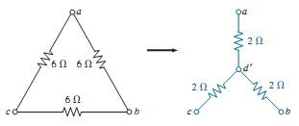
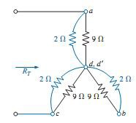
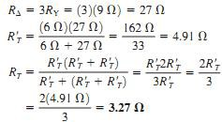
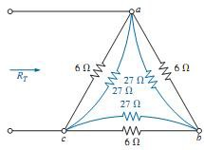
Solutions: Since all the resistors of the Δ or Y are the same,
a. Converting the Δ to a Y:
The network then appears as shown in Fig.
b. Converting the Y to a Δ :

Slide 11
H.W// Using a Δ-Y or Y- Δ conversion, find the current I in each of the networks

Slide 12
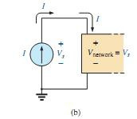
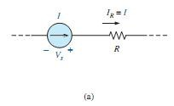
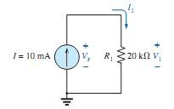
CURRENT SOURCES:
a current source determines the direction and magnitude of the current in the branch where it is located. the magnitude and the polarity of the voltage across a current source are each a function of the network to which the voltage is applied. A few examples will demonstrate the similarities between solving for the source current of a voltage source and the terminal voltage of a current source, so we just have to remember what we are looking for and properly understand the characteristics of each source. The symbol for a current source appears in Fig. (a). The arrow indicates the direction in which it is supplying current to the branch where it is located. The result is a current equal to the source current through the series resistor. In Fig. (b), we find that the voltage across a current source is determined by the polarity of the voltage drop caused by the current source. For single-source networks, it always has the polarity of Fig. (b).
EXAMPLE : Find the source voltage, the voltage V₁ , and current I₁ for the circuit in Fig.
Solution:

Slide 13
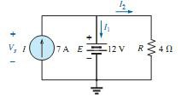
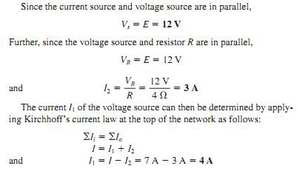
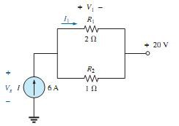
EXAMPLE : Find the voltage V_{S} and currents I₁ and I₂
for the network in Fig.
Solution:
EXAMPLE : Determine the current I1 and the voltage VS for the network in Fig.
Solution:
First note that the current in the branch with the current source must be 6 A, no matter what the magnitude of the voltage source to the right. In other words, the currents of the network are defined by I, R₁, and R₂ . However, the voltage across the current source is directly affected by the magnitude and polarity of the applied source.

Slide 14
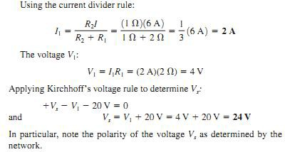
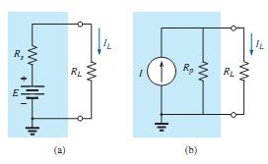
SOURCE CONVERSIONS:
The current source appearing is the previous section is called an source due to the absence of any internal resistance. In reality, all sources whether they are voltage sources or current sources have internal resistance in the relative positions shown in Fig. For the voltage source, if Rs = 0 , or if it is so small compared to any series resistors that it can be ignored, then we have an “ideal” voltage source for all practical purposes. For the current source, since the resistor RP is in parallel, if RP = ∞ , or if it is large enough compared to any parallel resistive elements that it can be ignored, then we have an “ideal” current source. Unfortunately, however, ideal sources cannot be converted from one type to another. That is, a voltage source cannot be converted to a current source, and vice versa—the internal resistance must be present. If the voltage source in Fig.(a) is to be equivalent to the source in Fig. (b).

Slide 15
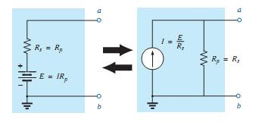
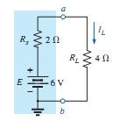
the load R_{L} would not know which source it was connected to. This type of equivalence is established using the equations appearing in Fig. below. First note that the resistance is the same in each configuration a nice advantage. For the voltage source equivalent, the voltage is determined by a simple application of Ohm’s law to the current source E = IR_{P}. For the current source equivalent, the current is again deter- mined by applying Ohm’s law to the voltage source:
I = E/Rs .
the equivalence between a current source and a voltage source exists only at their external terminals.
EXAMPLE : For the circuit in Fig. below:
Determine the current IL.
Convert the voltage source to a current source.
Using the resulting current source of part (b), calculate the current through the load resistor, and compare your answer to the result of part (a).

Slide 16
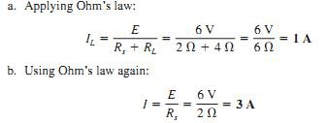
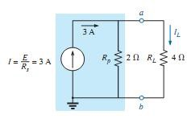
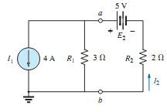
solution:
and the equivalent source appears in Fig. with the load reapplied.
Example:

Slide 17
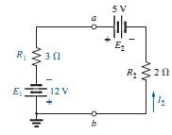
Solution:
CURRENT SOURCES IN PARALLEL:
We found that voltage sources of different terminal voltages cannot be placed in parallel because of a violation of Kirchhoff’s voltage law.
Similarly,
current sources of different values cannot be placed in series due to a violation of Kirchhoff’s current law. However, current sources can be placed in parallel just as voltage sources can be placed in series. In general, two or more current sources in parallel can be replaced by a single current source having a magnitude determined by the difference of the sum of the currents in one direction and the sum in the opposite direction. The new parallel internal resistance is the total resistance of the resulting parallel resistive elements.
EXAMPLE : Reduce the parallel current sources in Fig. to a single current source.

Slide 18
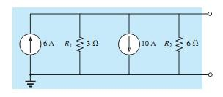
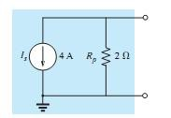
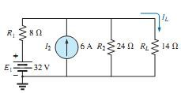
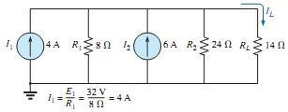
Solution:
EXAMPLE : Reduce the network in Fig. below to a single current source, and calculate the current through R_{L} .
Solution:

Slide 19
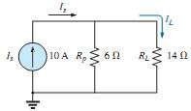
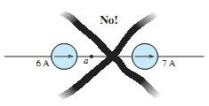
Note :

Slide 20
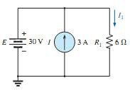
SUPERPOSITION THEOREM
The superposition theorem is unquestionably one of the most powerful in this field. It has such widespread application that people often apply it without recognizing that their exercises are valid only because of this theorem.
The superposition theorem states the following:
The current through, or voltage across, any element of a network is equal to the algebraic sum of the currents or voltages produced independently by each source.
-In other words, this theorem allows us to find a solution for a current or voltage using only one source at a time.
when removing a voltage source from a network schematic, replace it with a direct connection (short circuit) of zero ohms. Any internal resistance associated with the source must remain in the network.
Setting a current source to zero amperes is like replacing it with an open circuit. Therefore, when removing a current source from a network schematic, replace it by an open circuit of infinite ohms. Any internal resistance associated with the source must remain in the network.
The above statements are illustrated in Fig. below :
Since the effect of each source will be determined independently, the number of networks to be analyzed will equal the number of sources.
EXAMPLE : Using the superposition theorem, determine current I₁ for the network in Fig.

Slide 21
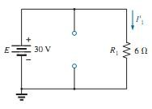
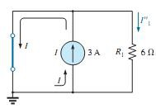
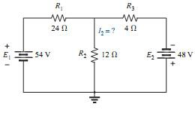
Solution:
First let us determine the effects of the voltage source by setting the current source to zero amperes as shown in Fig.
Now for the contribution due to the current source. Setting the voltage source to zero volts results in the network in Fig. Since the source current takes the path of least resistance, it chooses the zero ohm path of the inserted short-circuit equivalent, and the current through R ₁ is zero amperes. This is clearly demonstrated by an application of the current divider rule as follows:
EXAMPLE : Using the superposition theorem, determine the current through the 12Ω resistor in Fig.

Slide 22
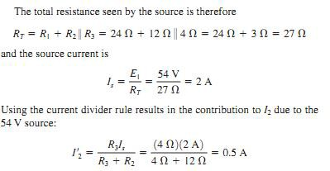
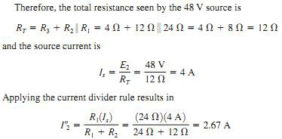
Solution:
If we now replace the 54 V source by a short-circuit equivalent, the network in Fig. results. The result is a parallel connection for the 12Ω and 24Ω resistors.

Slide 23
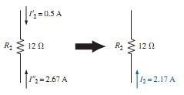
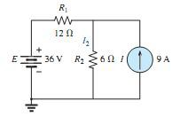
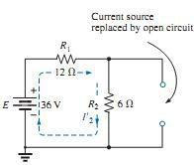
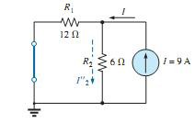
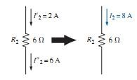
EXAMPLE :
a. Using the superposition theorem, determine the current through resistor R2 for the network in Fig.
Solution : a)

Slide 24
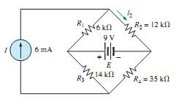
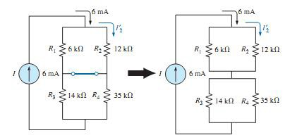
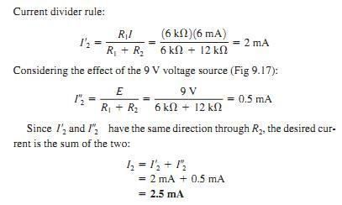
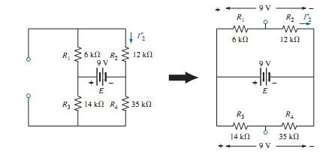
EXAMPLE : Using the principle of superposition, find the current I₂ through the 12 kΩ resistor in Fig.
Solution: Considering the effect of the 6 mA current source

